Slide 1
Electoral Registration
Principal speaker, Pete Wildman, Central Scotland Electoral Registration Officer and EMB Board Member

Slide 2
EROs in Scotland
15 EROs for 32 local authority areas
Independent and answerable to courts
Personal duty and responsibility
Funded by local authorities
SAA represents all Scottish EROs
Electoral Commission – performance monitoring & non-statutory guidance
Electoral Management Board – coordination and directions

Slide 3
Role of the ERO
Compile and maintain a complete and accurate electoral register for their area
Registers are published annually (usually 1 December)
Registers updated at the start of each month Annual Household Enquiries (July to November)
Maintain absent voter records i.e. who can vote by post or by proxy.

Slide 4
Role of the ERO – Other matters
Anonymous registration
Declarations of local connection
Armed services voters
Prisoners
Foreign Nationals

Slide 5
ERO role in elections
Good liaison with Returning Officers and their Teams
Advance Indicator of Elector Engagement
Produces Data Files for Poll Card/Postal Vote Issues
Three Updates to the Register ahead of an Election
Produces ballot box Registers for Polling Stations

Slide 6
ERO role in elections
Determines if an Elector should be granted an Emergency Proxy
On Polling Day support for Polling Station Teams in identifying electors on Register
Determining Clerical Errors
Register is definitive as to who can vote.

Slide 7
Key themes for 2022 polls
TV Advertising Promoting Postal Vote Deadline
Household Notification Letters in most areas
Registration Deadline 18 April 2022
Postal Vote Deadline 19 April 2022
Emergency Proxy provisions relating to Covid still in force

Slide 8
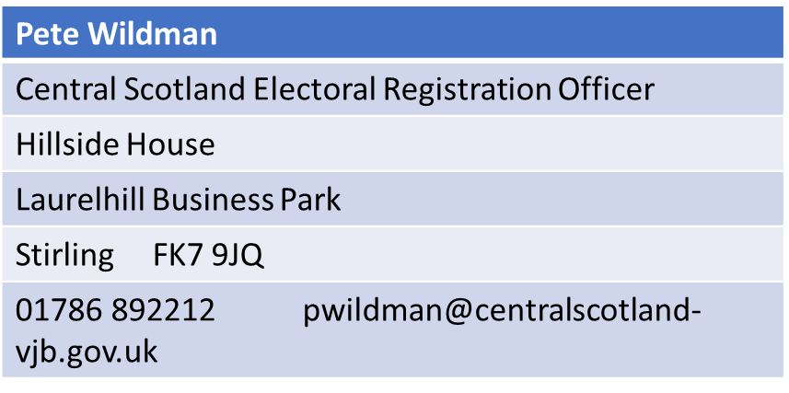
Contact details

