Slide 1
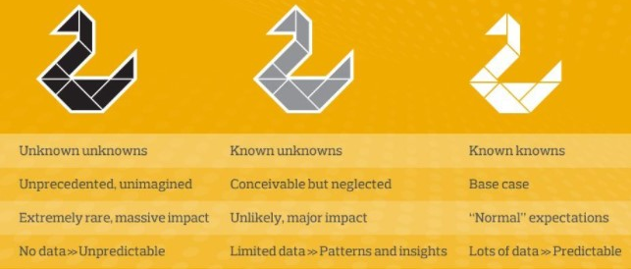
The rise of the Grey Swan attacks
Keith McDevitt
Cyber Resilience Integrator
Cyber Resilience Unit
Scottish Government

Slide 2
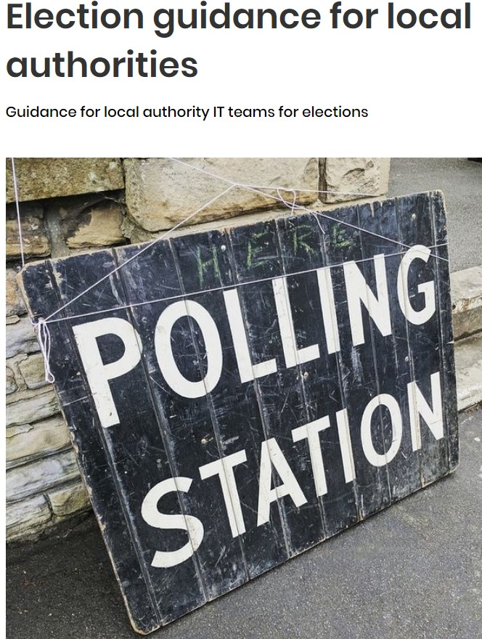
Election guidance for local authorities - NCSC.GOV.UK
1.The risks
2.Case studies
3.Protecting your systems
4.Protecting your people
5.Where to get extra help
Getting the Cyber Basics Right goes along way to mitigating any cyber risk

Slide 3
Cyber more likely as an unintentional disruptor
The UK system does not lend itself to electronic manipulation; voting and counting of ballots English local elections are manual processes. However, there are some areas that could be vulnerable to cyber operations. These sorts of operations include:
DDoS attacks, particularly against electoral, government or media websites making them unavailable at key moments during an electoral campaign (for example shortly before the deadline for voter registration, or on election day itself).
Attempts to obtain user names and passwords and other personal information. Commonly used social engineering tactics include phishing (emails that encourage the recipient to click on malicious links or attachments) and spear-phishing (content tailored for the recipient, making it more likely they will click on the malicious link). Internet-connected databases may also be of interest to attackers.
Attempts to forge or send fake emails and other communications. It is relatively easy to compose convincing fake emails, and compromised email accounts may be used by attackers for this purpose
A significant cyber attack such as ransomware that disrupts organisational ability to deliver services

Slide 4
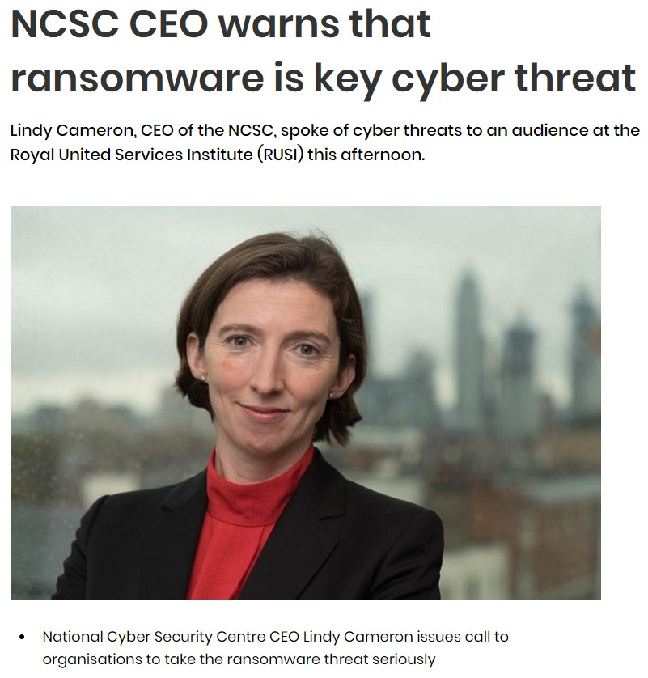
Current Threat Picture
Two significant threats have developed that are of a major concern and are worth singling out
Extortion and Supply Chain Threats
Extortion through Ransomware. This has evolved from being of a technical inconvenience to a serious threat to an organisations ability to deliver service and in some instances for those un-prepared to survive the attack.
Double Extortion: encrypt and delete organisational data at server level; but seek to attack back-ups and also exfiltrated valuable data which is also used to force the demand to pay and also as a double extortion technique.
Extortion through data theft with no ransomware, stealing sensitive data and threatening to publish on leak sites
Primary route of access, organisations supply chain and staff

Slide 5
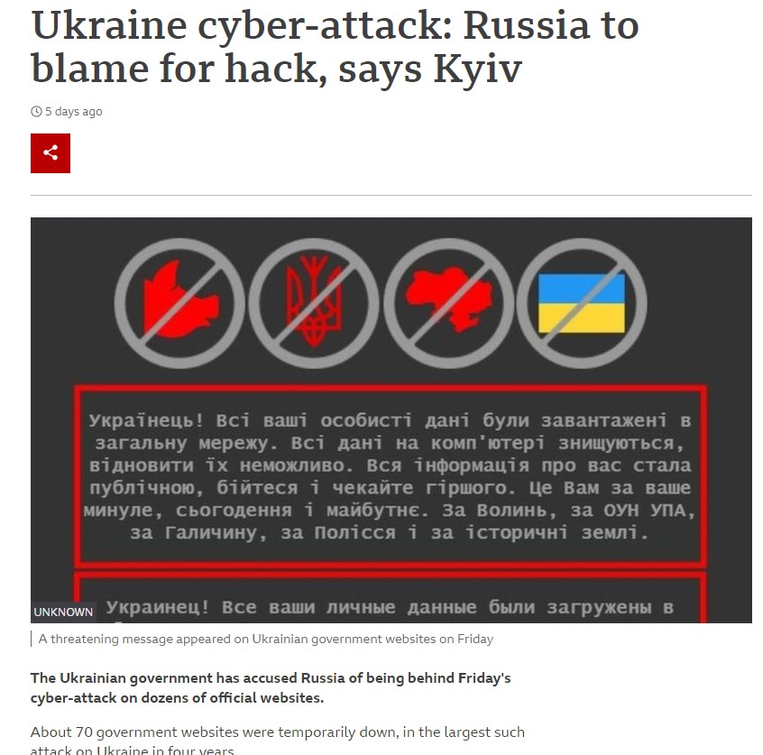
Threat Picture – attacks at scale
Complex Supply Chain attacks are on the rise particularly those within the IT Managed Service sector It makes sense compromise and organisation that has a large customer base reliant on its service and you have the potential to gain an easy route in to their clients. These are services we rely on and trust
2021 will be remembered for attacks against the software supply chain. Prominent attacks against SolarWinds, Microsoft Exchange, Kaseya and Log4J highlighted the collateral impact and potential reach of targeting the software supply chain.
It is of course no surprise that we now see Extortion, Ransomware and Supply Chain attacks mixed with supply chain as the compromise delivery model.
Not all footholds into an organisations networks are exploited immediately

Slide 6
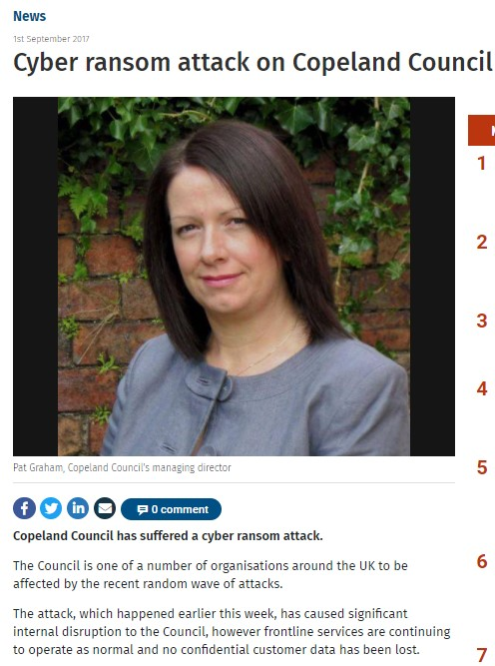
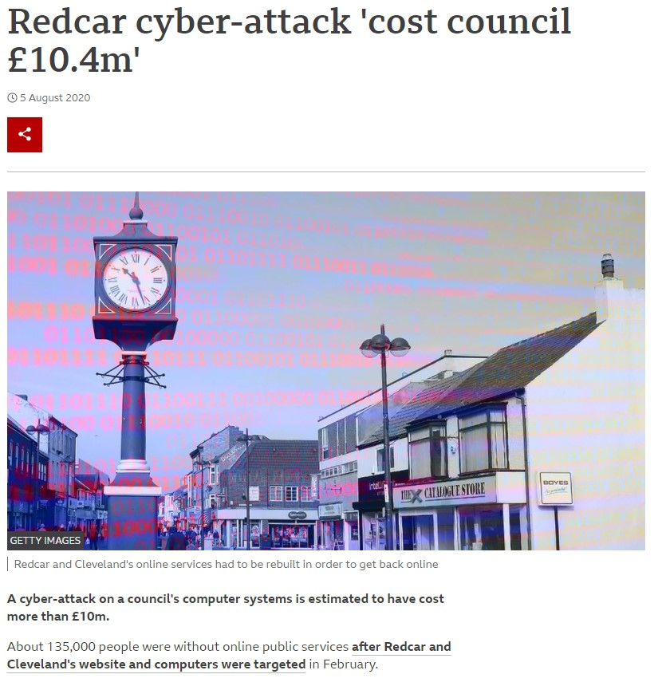
Most devastating attacks tend to involve large scale collateral damage – it’s a lottery

Slide 7
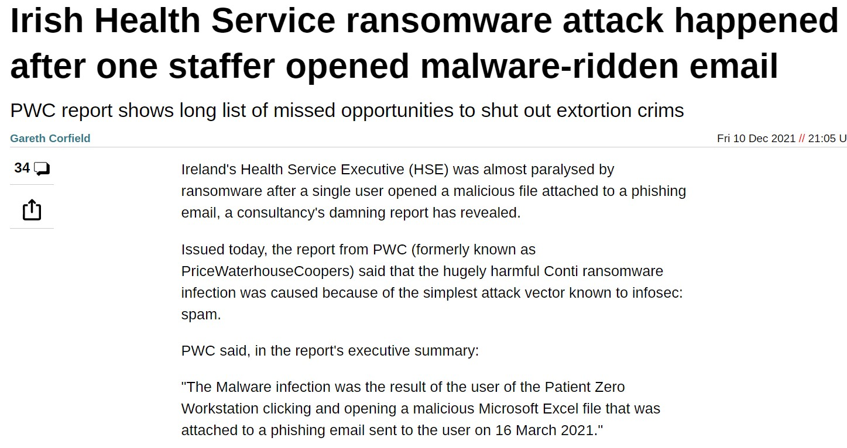
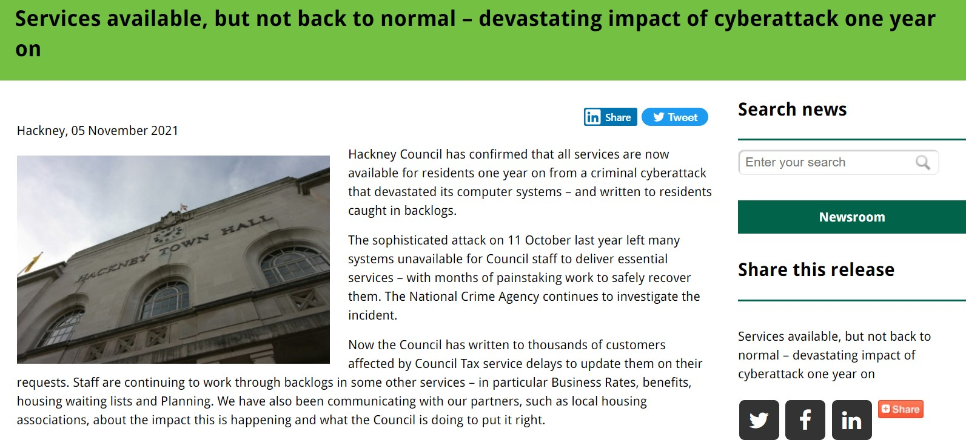
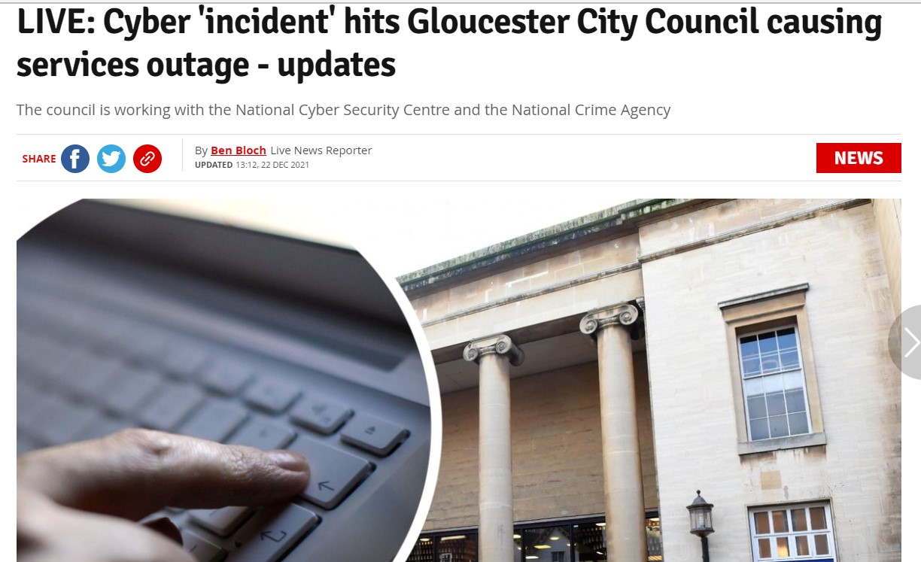
The removal of the ability to use phone and email is now common and very disruptive

Slide 8
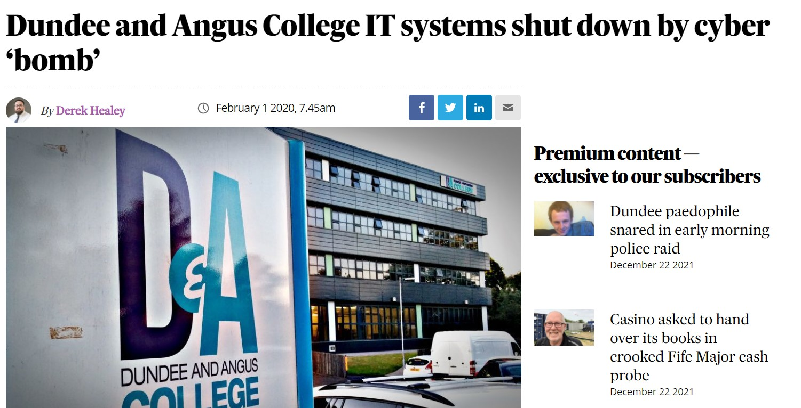
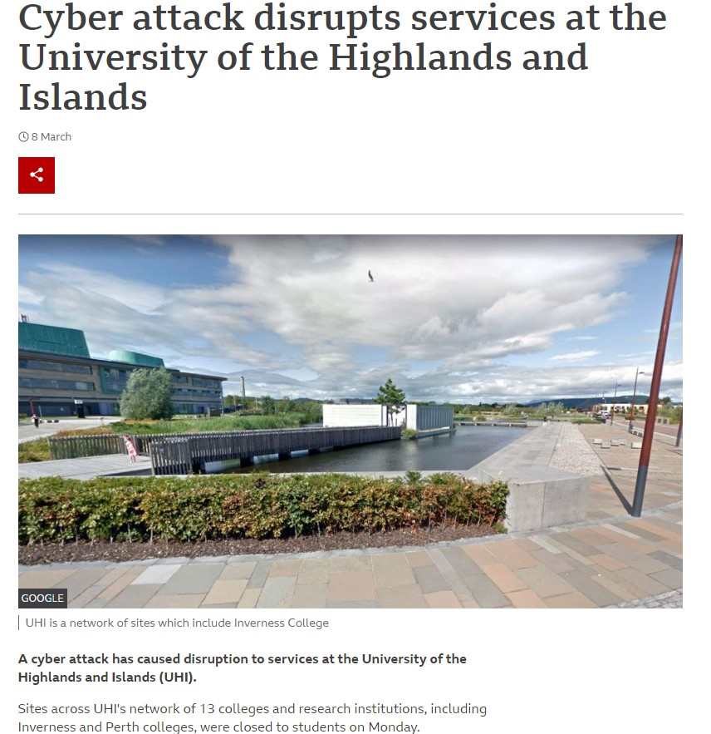
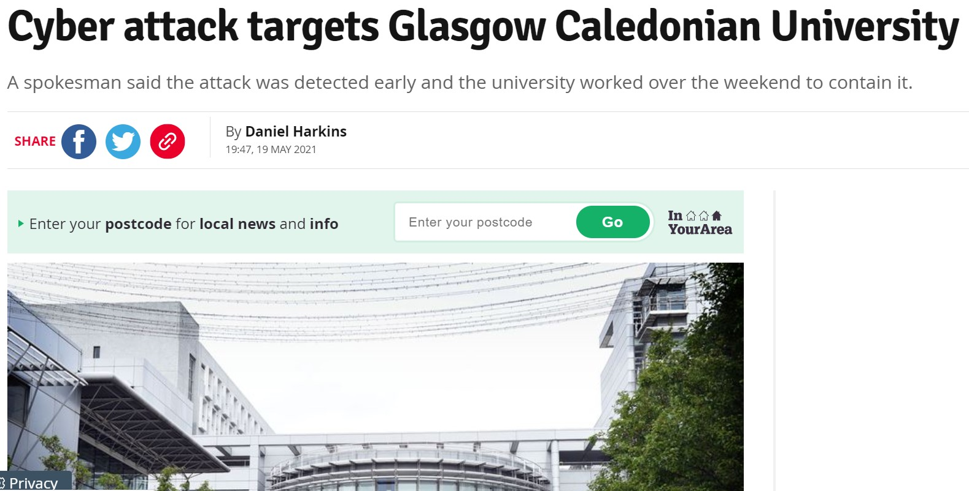

Slide 9
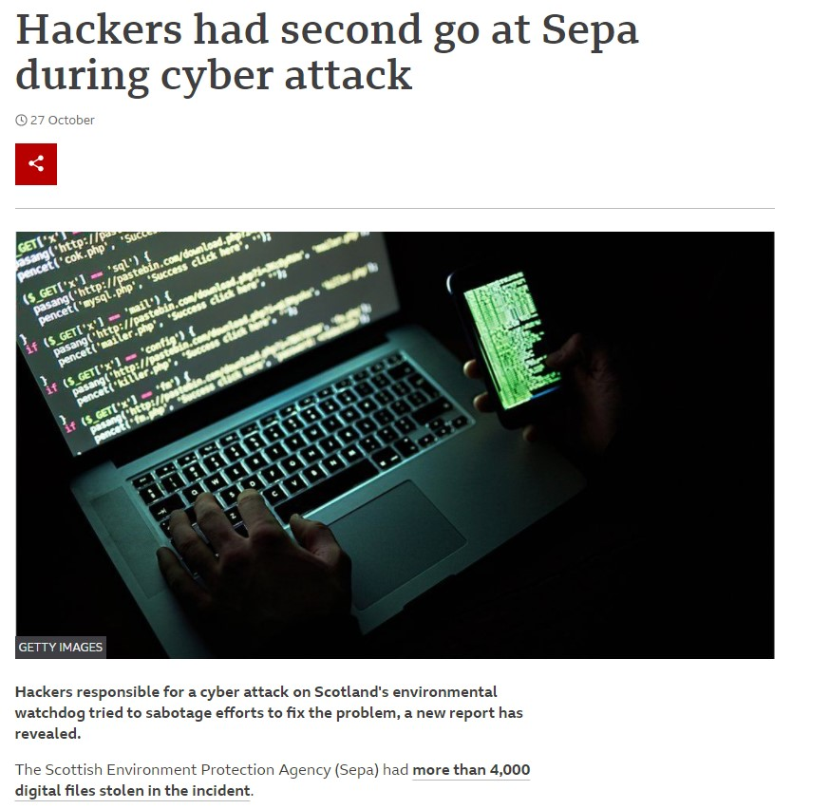

Slide 10
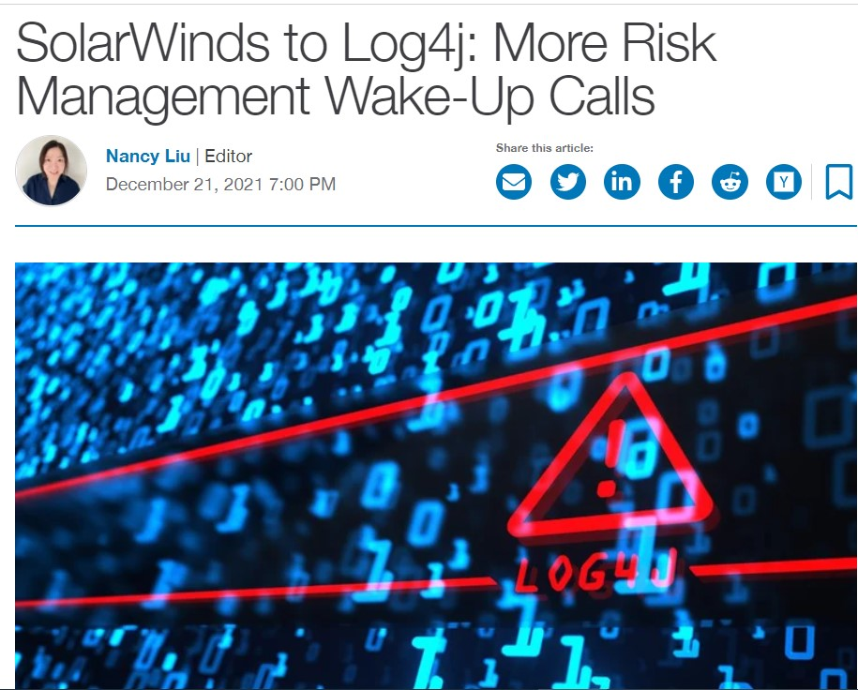
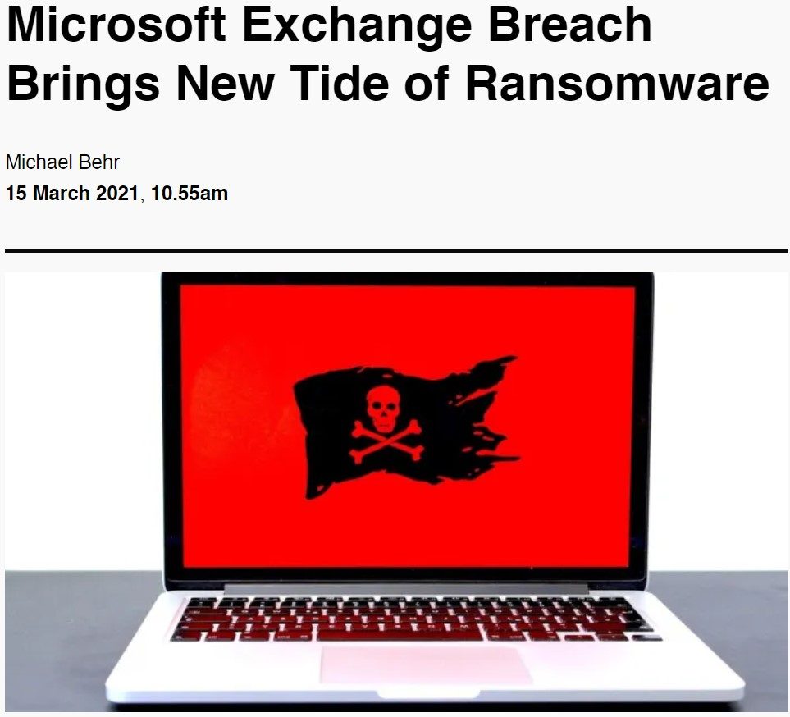

Slide 11
Reality around internet borne risks
Service suppliers represent a risk, how does your organisation manage them to gain assurance that this risk is managed?
Staff are still the easiest route into your network, it juts takes an inadvertent click. What is being done to train them to recognise the risks?
The risk and impact are increasing especially for low probability high impact events. Is your prepared for this risk? Has it been exercised?
Exercising the Grey Swan events is a good way to understand organisational readiness?

Slide 12
Responding to the increasing risks: Building our National Cyber Co-ordination Capability
February 2021, the Deputy First Minister launched the Strategic Framework for a Cyber Resilient Scotland which aims to support people and organisations to protect against, prepare for and recover from cyber threat and attack.
The Framework committed to explore options for improving the cyber security capabilities and resilience of the public sector and in light of recent serious incidents in Scotland and worldwide, the Scottish Government’s Covid Recovery Strategy highlights the need to bring forward the establishment of a recognised, authoritative and collaborative function to combat the accelerating threat of cyber attack to Scotland.
This will build on our existing national cyber co-ordination plan

Slide 13
Scottish Public Sector Cyber Resilience Framework (SPSCRF)
This survey continues to probe the areas covered in previous surveys, including governance, risk management, information sharing, independent assurance of critical technical controls, staff training and awareness, incident response and exercising.
It aims to reinforce the importance of good cyber security and resilience, promote an improved baseline standard across the sector
It will also seek assurances on key cyber security aspects highlighted during recent cyber attacks, including the SEPA incident; in particular, around the use of managed service providers, back-up and recovery arrangements, as well as pre-existing relationships with specialist cyber incident response companies

Slide 14
Scottish Public Sector Cyber Resilience Framework (SPSCRF) – Beyond the basics
Use of Managed Service Providers
Governance and Risk Management
Intelligence and Information Sharing specifically use of the Cisp
Critical Technical Controls independently assured its critical technical controls
NCSC Active Cyber Defence Measures: Web Check, Mail Check, Protective DNS, Early Warning, Exercise in a Box.
Staff Training and Awareness
Supply Chain Cyber Security & Resilience
Incident Response and Exercising
Stage within the Scottish Public Sector Cyber Resilience Framework
Backups and System Recovery
Are your organisation’s backups offline and/or immutable?
Has your organisation tested the recovery of systems from backups?

Slide 15
Time for questions

Slide 16
Contact keith.mcdevitt@gov.scot

